Slide 1
Stress Testing Examples
William R. Davidson, Jr., M.D.
Cardiology
Penn State College of Medicine

Slide 2
Directions
Most slides have text below.
Read through the text first
Then go back and run the slide show to see the echo images moving.
Or, alternate slide by slide (only the echo images move)

Slide 3
Case 1
Healthy 60 year old male MD with atypical (in his mind) chest pain
Mild hypercholesterolemia
No hypertension, smoking, diabetes or family history of CAD
Notes:
The patient had a normal EKG, but had a 50% chance of having coronary artery disease. An imaging stress would have been a better choice.

Slide 4
Case 1: Positive Exercise EKG Note deep, flat ST segment depressions in multiple leads, most classic in V4-V6. Patient only attained 6 minutes on a Bruce protocol.
Resting EKG
Immediately Post Exercise
Notes:
The patient walks on a treadmill with progressive increases in speed and elevation. Failure to reach 9 minutes is a sign of poorer prognosis, and so are the deep ST depressions which lasted > 10 minutes in this patient.

Slide 5
Same patient, 5 minutes into exercise. Note salvos of brief ischemic polymorphic ventricular tachycardia.
Notes:
The VT precipitated by exercise is another sign of severe disease.

Slide 6
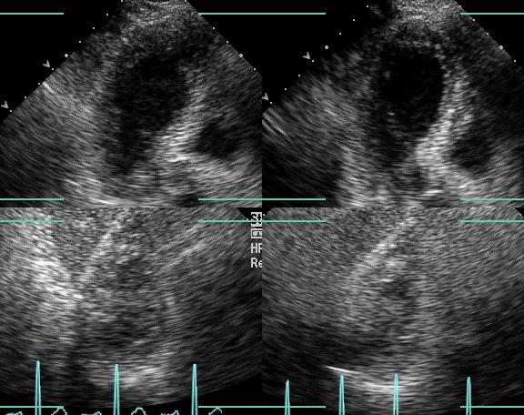
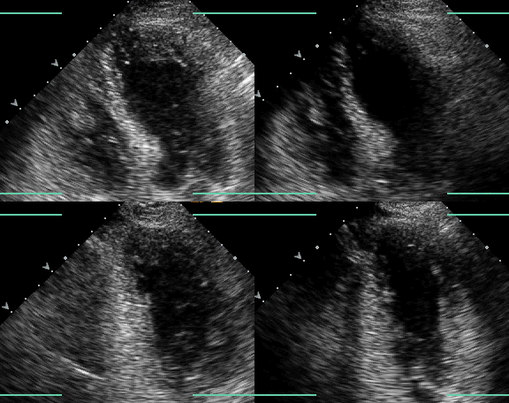
Case 2 – A negative stress echo. The LV becomes smaller and more vigorous between rest and immediately post-exercise.
Short axis view
Rest Post-exercise
Apical 4 Chamber view
Rest Post-exercise
Notes:
4 standard views are displayed with rest and post-exercise images side by side. The reader looks for both global improved contractility and decreased LV size with exercise . There are 17 myocardial segments evaluated for evidence of regional ischemia. All segments contracted normally with exercise here.

Slide 7
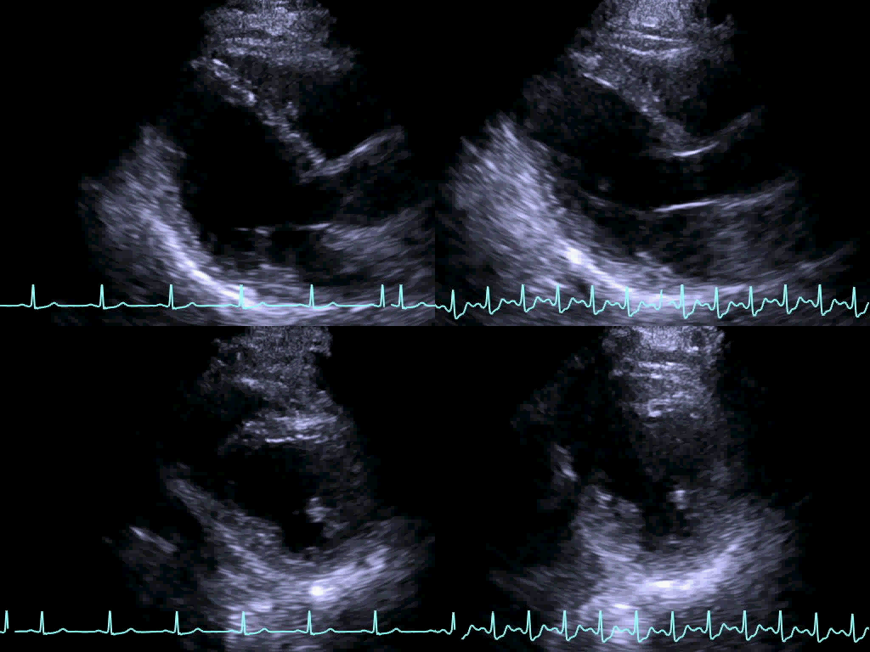
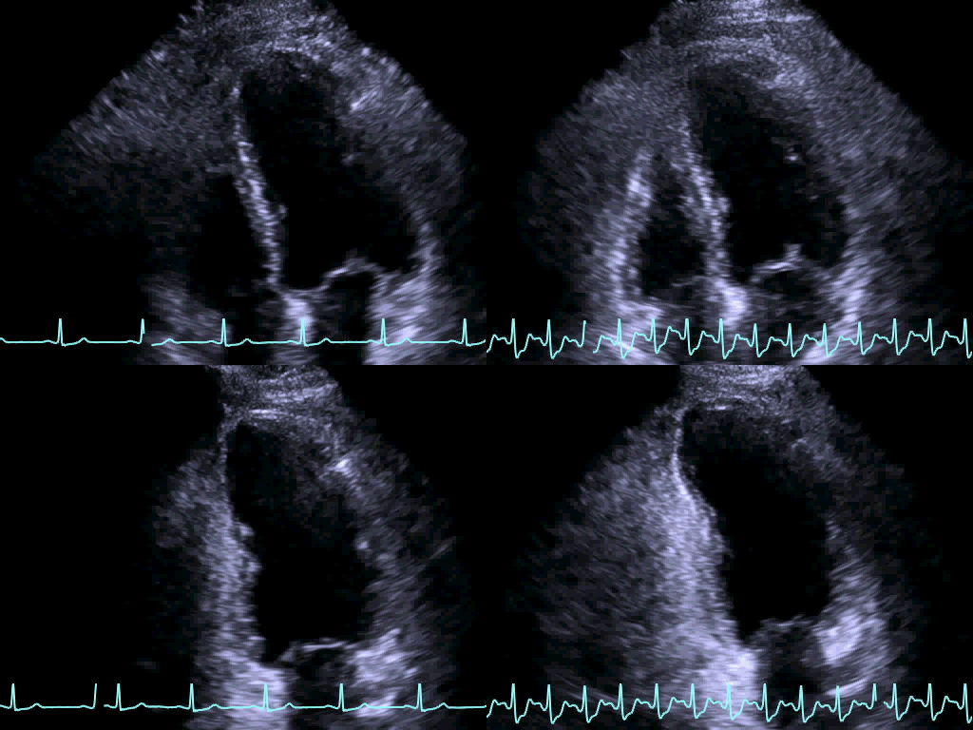
Back to Case 1 – Markedly positive stress echo in LAD territory. The LV dilated after exercise, became less vigorous, and the septum and apex became hypo- to akinetic (arrows).
Rest Post-exercise
Rest Post-exercise
Notes:
These are the stress echo images from Case 1. Notice the more proximal portions of the LV contract more vigorously post-exercise, unlike the distal septum and apex (indicated by the arrows). Not only were many segments ischemic (thickened less well post-exercise), the entire LV dilates and is less vigorous. This patient went straight to coronary angiography and then underwent urgent coronary artery bypass grafting (CABG).

Slide 8
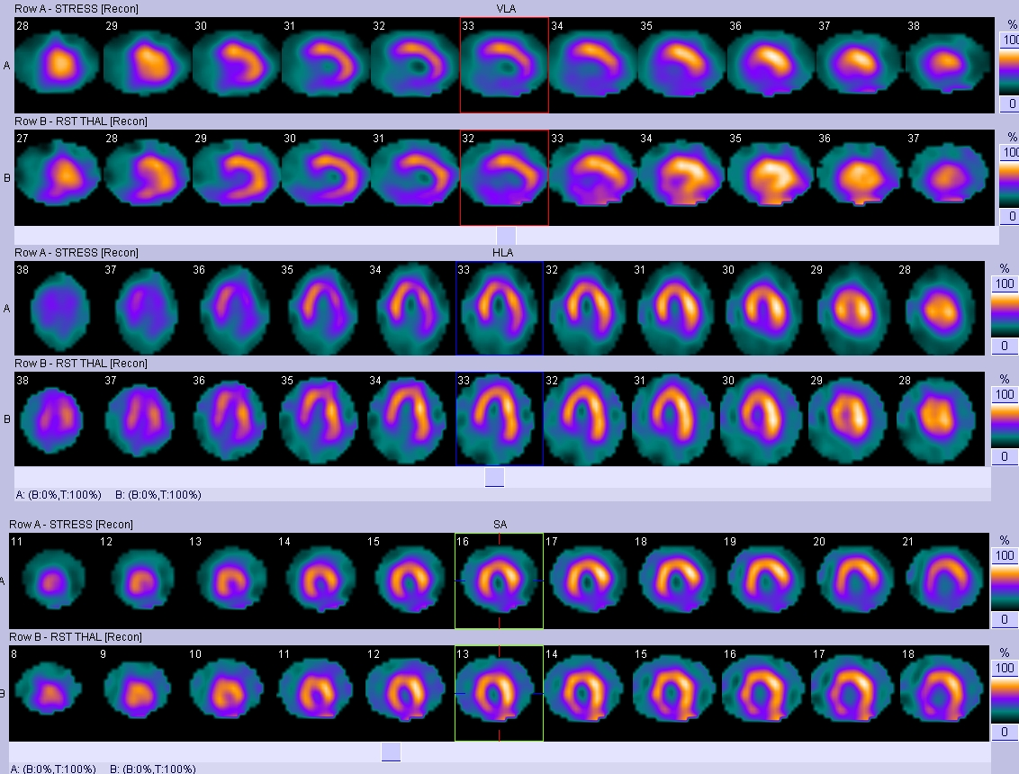
Case 4 – Defect seen in horizontal long axis view (top 2 rows are HLA post-stress and recovery) and short axis views (bottom 2 rows). The defect is present at both stages of the study, a partly fixed defect consistent with an infarct plus ischemia. Normally rows A and B of a view should be filled in uniformly and match in appearance.
65 year old man
Smoker
Diabetes
Hypertension
Mixed dyslipidemia
Notes:
The perfusion defect demonstrates a lack of uniform myocardial uptake of the radionuclide agent 4 hours after exercise. Defects which do not re-perfuse at rest are scars (fibrous scan after prior myocardial infarction). Defects which show increased uptake at rest compared to exercise are ischemic with exercise but normal at rest (not dead myocardium, but myocardium supplied by a stenotic coronary artery). This defect suggests a Left Circumflex territory infarct with peri-infarct ischemia.
HLA = horizontal long axis
Red arrows show the larger defect after exercise, which has improved with rest as shown at the yellow arrows.

Slide 9
Case 5 - Lateral wall and apical defect seen in rows labelled “A” (immediate post stress), but not rows labelled “B” (4 hour recovery images). Complete reperfusion suggests an ischemia lesion.
43 year old woman
Diabetes x 10 years
Elevated LDL cholesterol
Repaired coarctation as a child
Persistent HTN
Notes:
Here is an anterolateral ischemic defect without an infarct in the anterolateral and lateral walls. This could be due to stenosis in either the left circumflex or in diagonal arteries of the left anterior descending artery. Considering the normal variability of the coronary arteries, from this alone, we cannot be sure which vessel is the culprit one.

Slide 10
ThankYou!

